Slide 1

MY MOVIE RECOMMENDATION SYSTEM
ALMA
CEDRIC
MARINA
PAULO

Slide 2
What? Movie Recommendation
When? 5 Weeks
How? Using Machine Learning Algorithms to provide
movie recommendation based on previous liked movies
By Whom? Wild Code School Data Analysts
SCOPE OF THE PROJECT

Slide 3
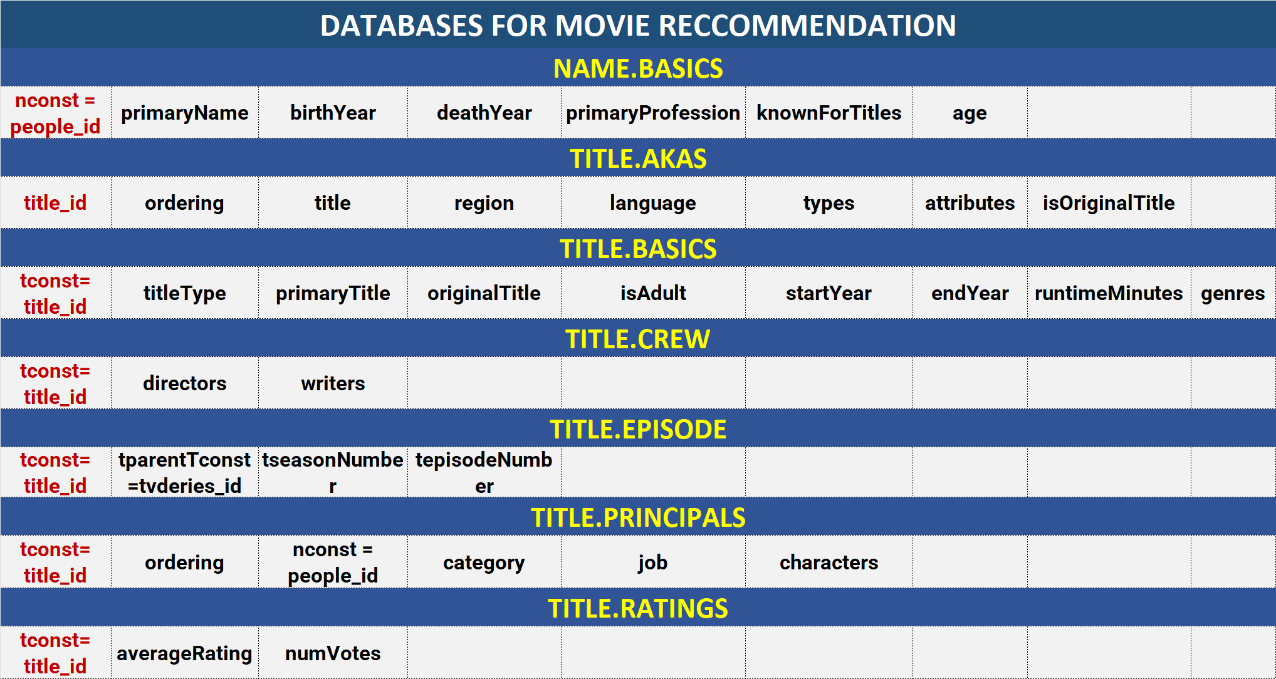
DATABASE CONTENT

Slide 4
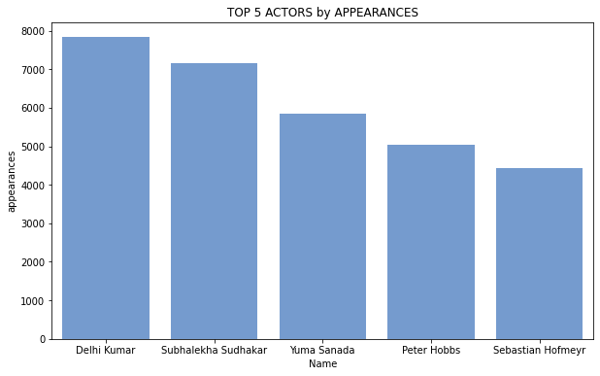
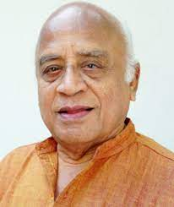




Top 5 actors

Slide 5
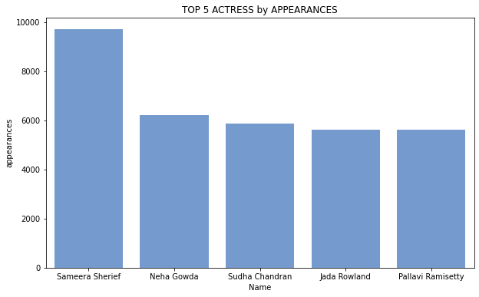





Top 5 actresses

Slide 6
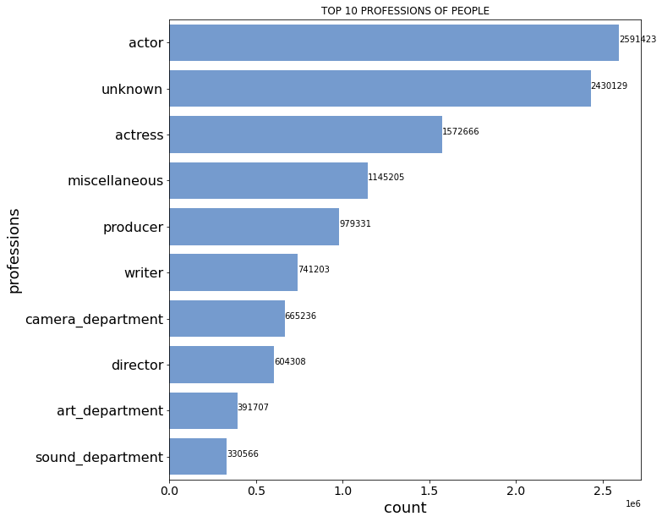
Movies Professions Statistics

Slide 7
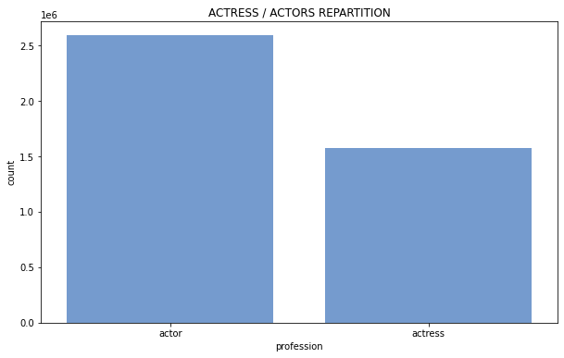
Actors Statistics
Average Age Actor/Actress today
 | Actor | Actress
Dead | 69.59 | 72.83
Alive | 52.68 | 49.67

Slide 8
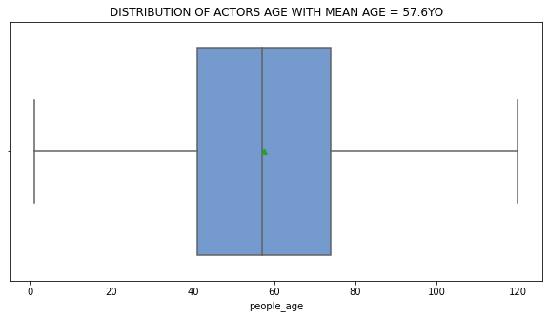
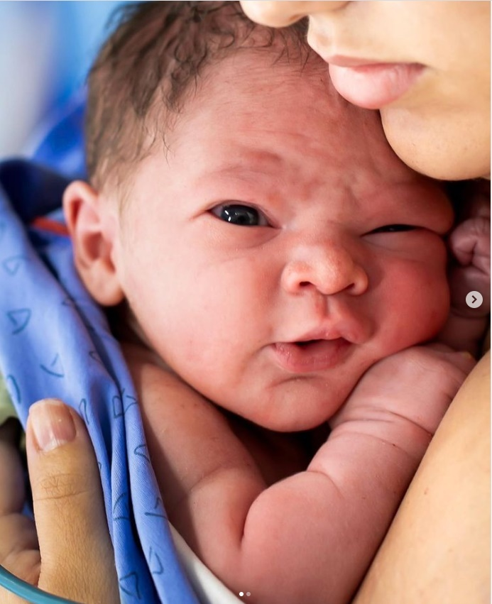
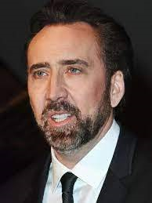
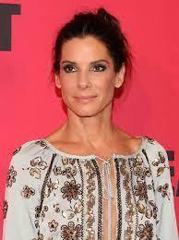

Actors Statistics

Slide 9
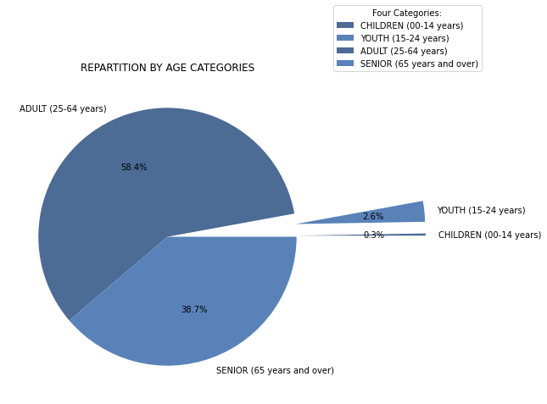
Actors Statistics (Age/ Category)

Slide 10
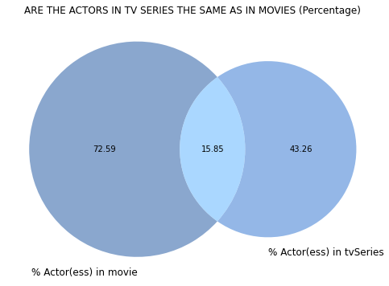
Actors Statistics (movies/ TV series)

Slide 11
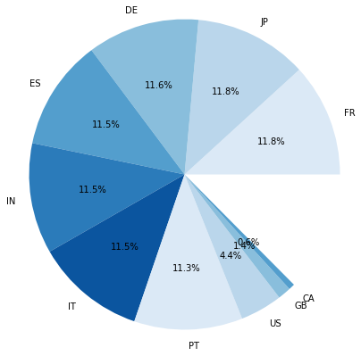
Countries produce more movies/series

Slide 12










Top 10 movies with highest votes:
Movies Statistics
Num.votes: 2,442,432
Rating: 9
Year: 2008 Minutes:152
Num.votes: 2,191,693
Rating: 8.8
Year: 2010
Minutes:148
Num.votes: 1,960,728
Rating: 8.8
Year: 1999
Minutes:139
Num.votes: 1,924,688 Rating: 8.9
Year: 1994
Minutes:154
Number of votes: 2,489,727
Rating: 9.3
Year: 1994
Minutes: 142
Num.votes: 1,923,671 Rating: 8.8
Year:1994 Minutes:142
Num.votes: 1,776,732
Rating: 8.7
Year: 1999
Minutes: 136
Num.votes: 1,743,718
Rating: 8.8
Year: 2001
Minutes:178
Num.votes: 1,722,424
Rating: 8.9
Year: 2003
Minutes:201
Num.votes: 1,717,256
Rating: 9.2
Year: 1972
Minutes:175

Slide 13
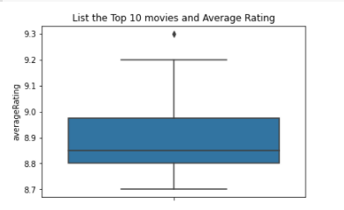
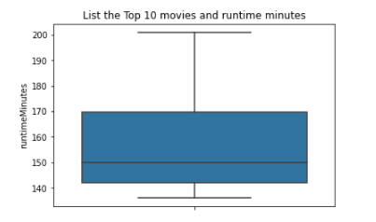
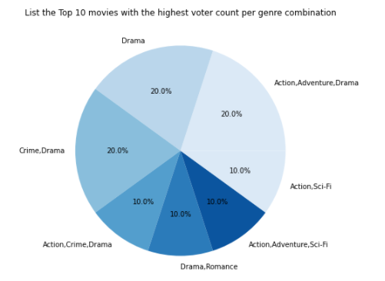
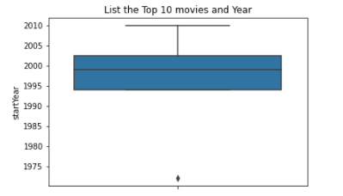
Movies Statistics
(Top 10 movies)

Slide 14






Top 2 movies between years 2018 and 2020:
Movies Statistics
Num of votes: 940,798
Rating: 8.4
Year: 2018
Num of votes: 685,926
Rating: 7.3
Year:2018
Num of votes: 1,094,544
Rating: 8.4
Year: 2019
Number of votes 2,487,195
Rating: 9.3
Num of votes: 960,530
Rating: 8.4
Year: 2019
Num of votes: 435,572
Rating: 7.4
Year: 2020
Num of votes: 284,654
Rating: 8.1
Year: 2020

Slide 15
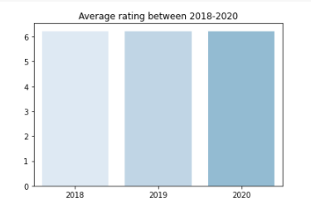
Averages
Movies Statistics

Slide 16
RECOMMENDATION SYSTEM

Slide 17
THANK YOU!

Slide 18
QUESTIONS?

